Slide 1
motivation
There are some HS that are diffusive looking, and some not, but they all mostly bedrock.
Need fig showing some diffusive and some not

Slide 2
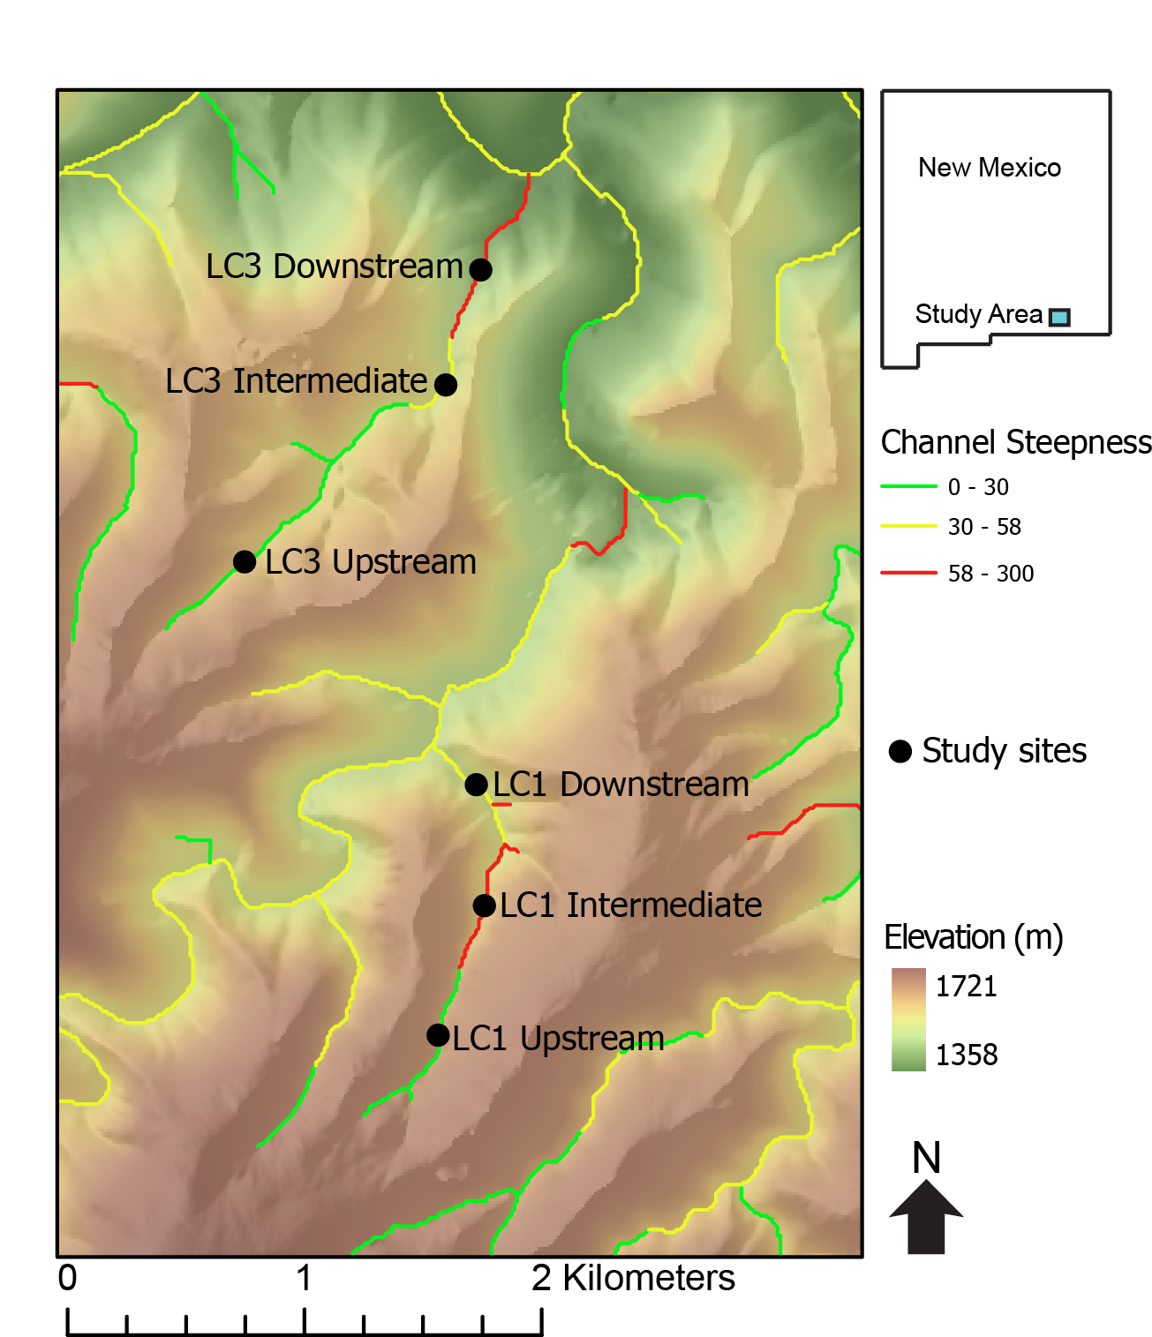
Other LC3 Upstream

Slide 3
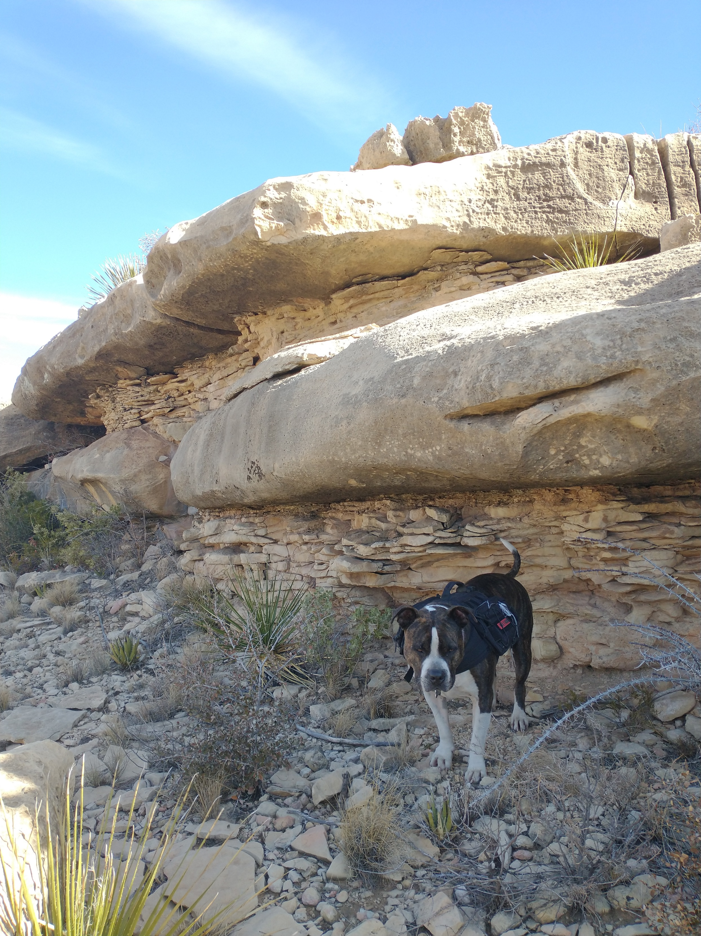
Notes:
There are also some really thinly bedded rock units in Last Chance canyon. Here is Remington posing in front of some carbonates which are laying on top of some very very thinly bedded sandstones. If I had to guess, I would imagine that these sandstones would not be able to hold a slope like the massive carbonate in the last slide.

Slide 4
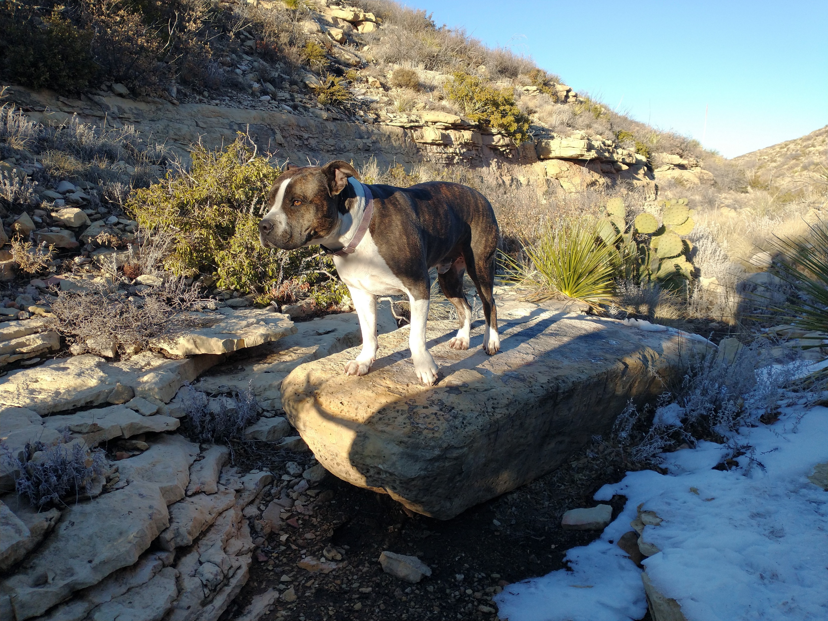
Shape factor = Dmin/Dmax
c
b
a
Notes:
Aside from collecting data regarding bedrock properties, I measured the largest boulder at every 40 ft elevation contour for the five different surveyed streams. I measured distance along three axis. The longest, the a axis, the second longest, the b axis and the shortest, the c axis. With this data I was able to calculate boulder volume, shape factor, and investigate how bed thickness affects the length of each of the three axis.

Slide 6
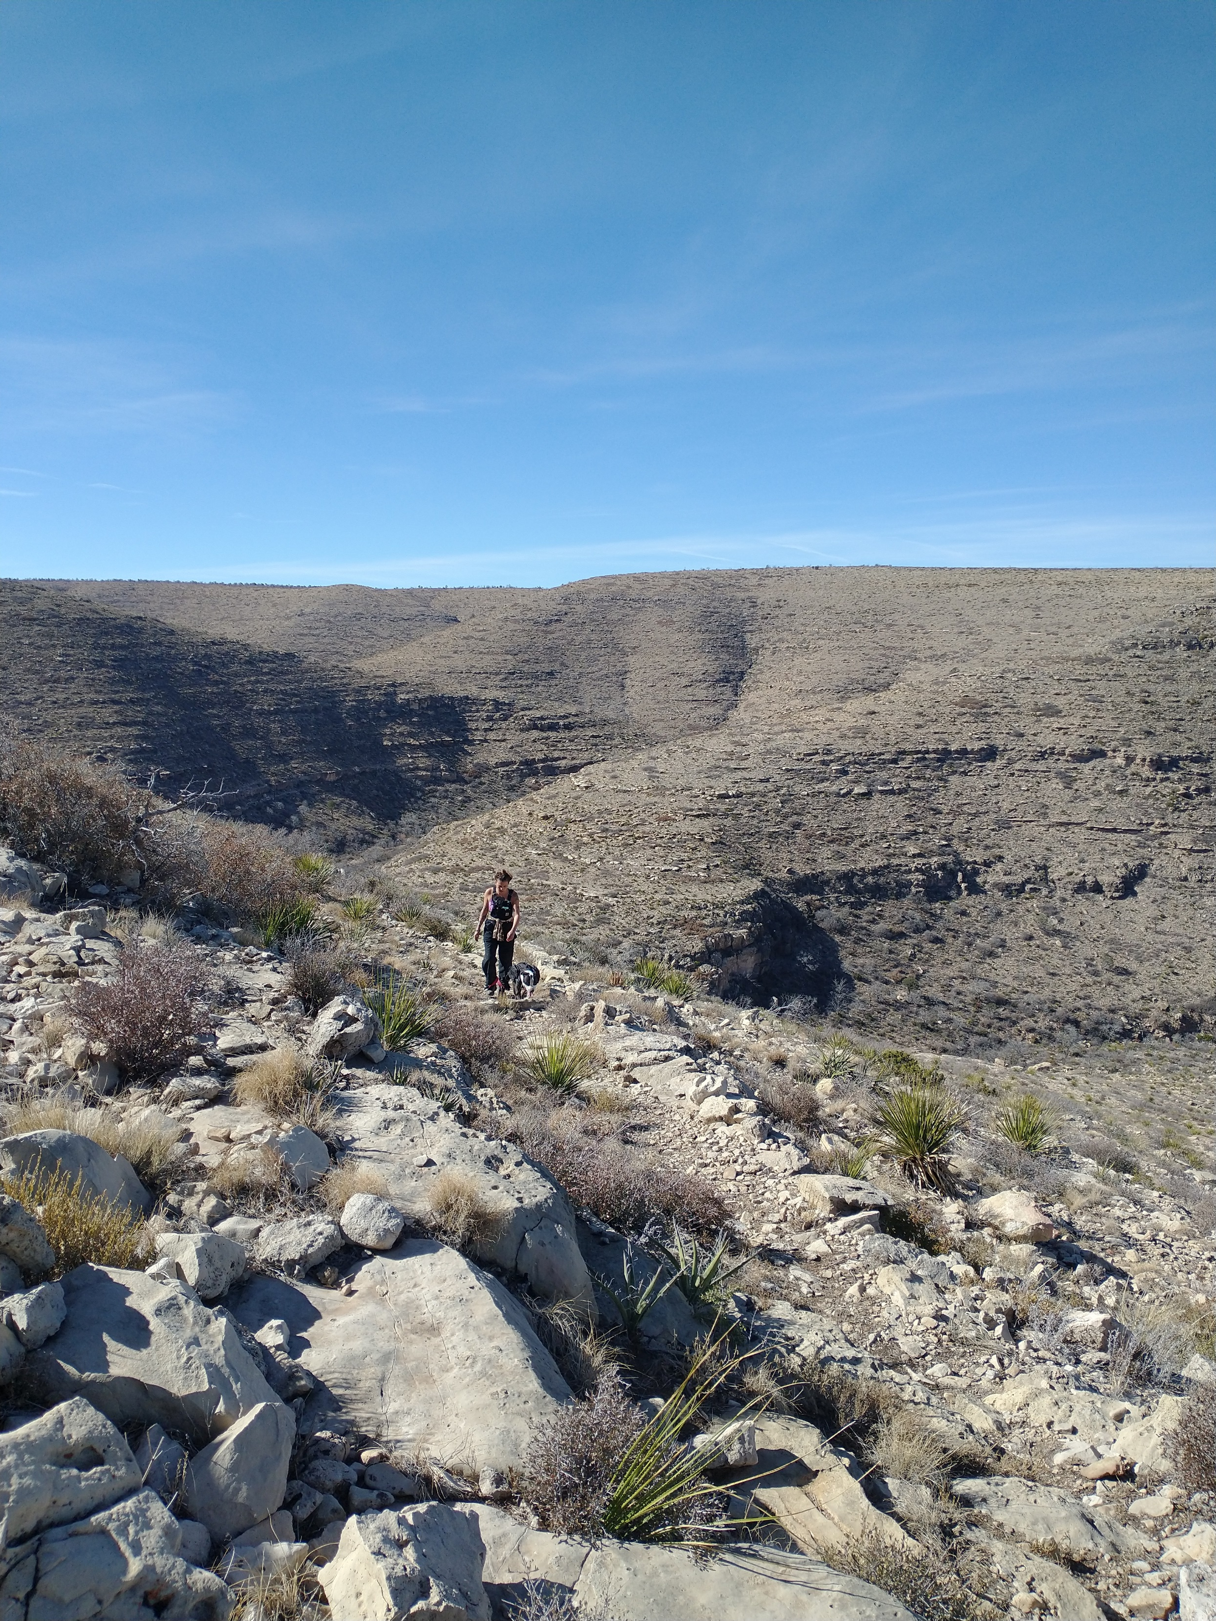
Notes:
…as are hillslopes. Making hiking quite difficult. These are from elevations above 1640m in LC1

Slide 7
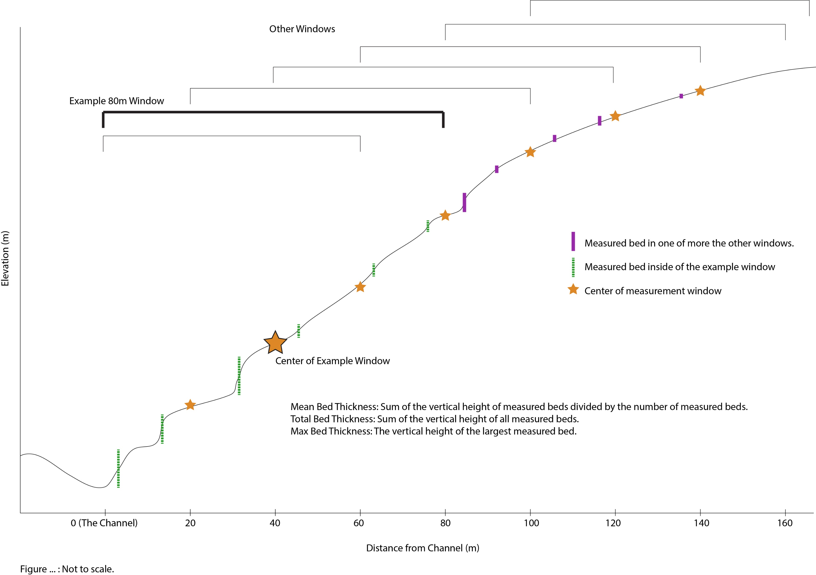

Slide 12
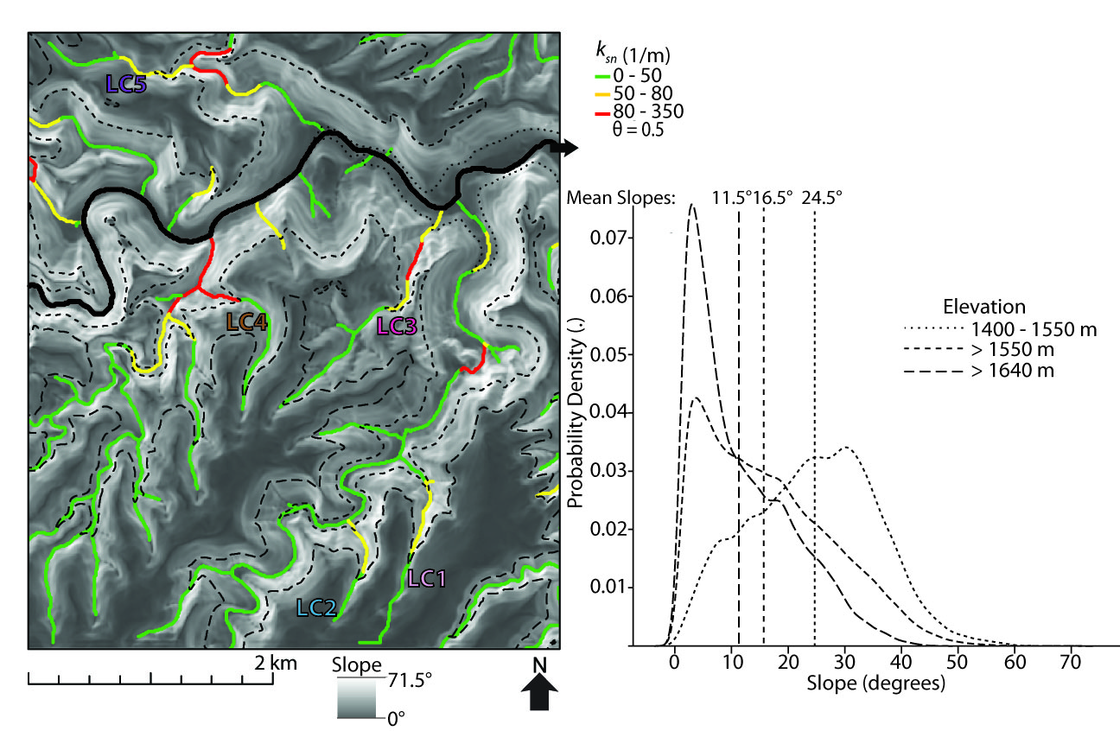

Slide 16
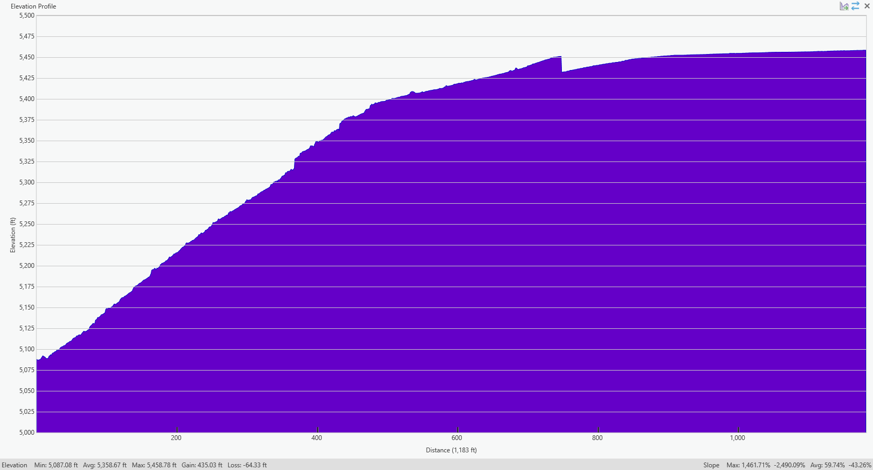

Slide 17
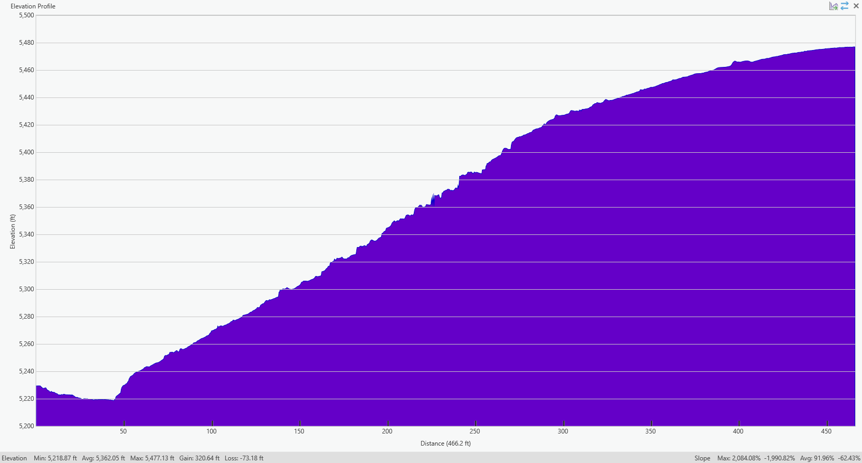
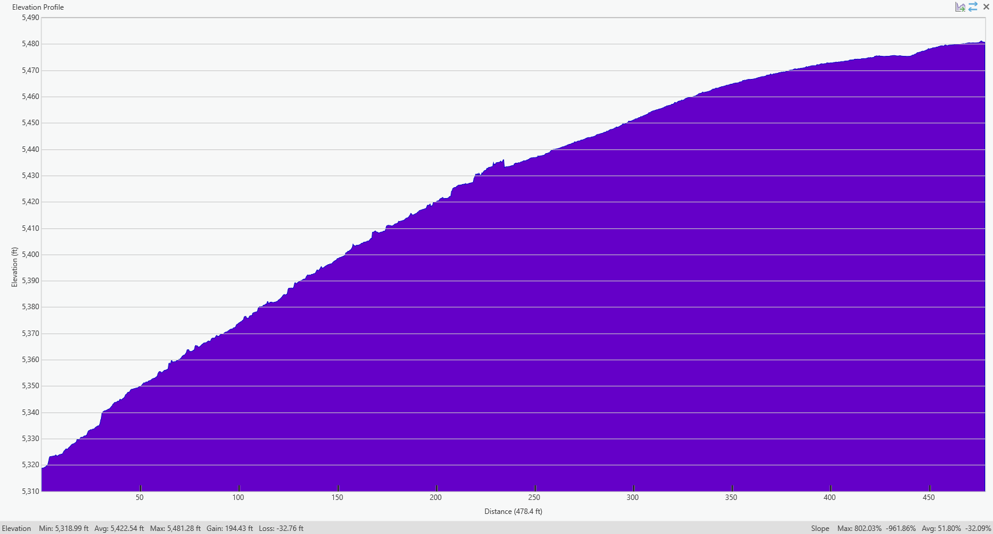

Slide 18
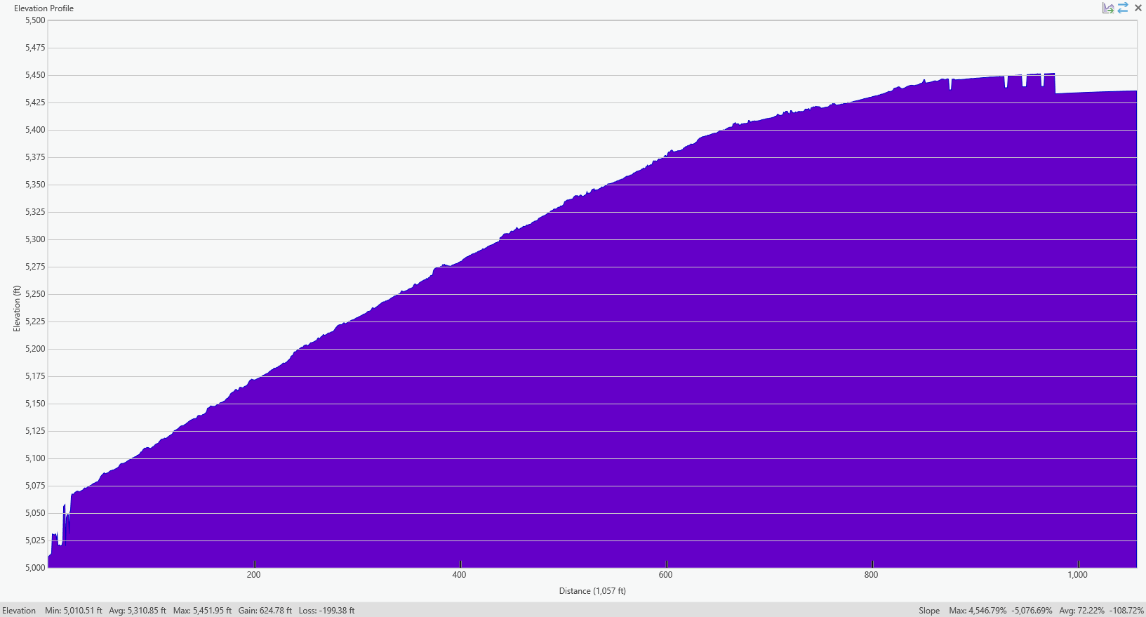

Slide 19
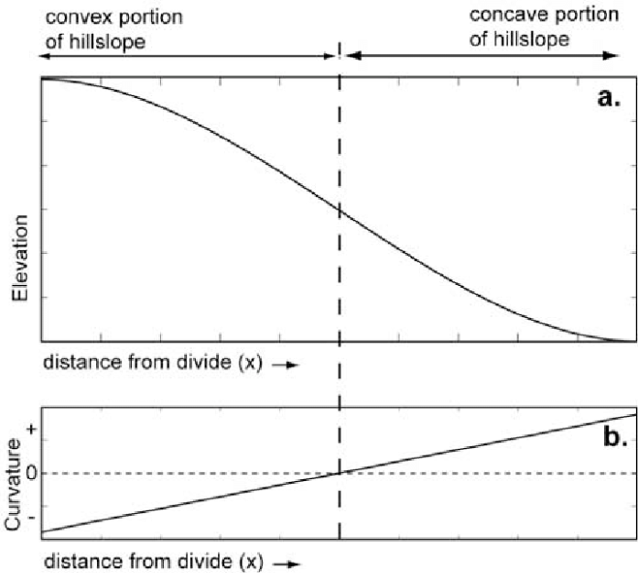
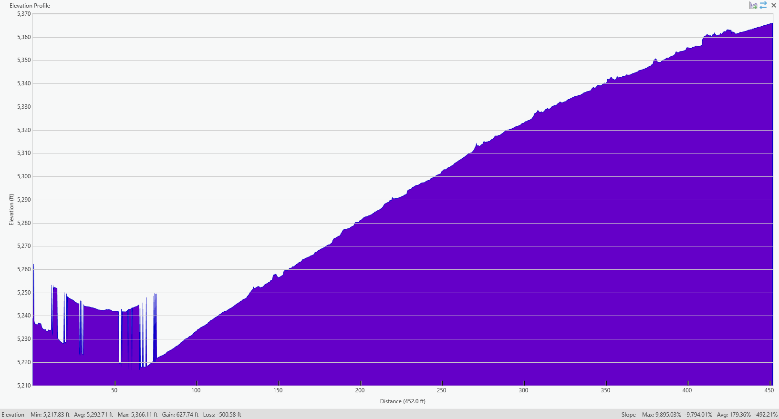
LC3 Shallow 1 is weird

Slide 20
Notes:
Have 3 of the 4 lowest standard deviations in bed thickness, mean bed thicknesses and max bed thickness. The other one is the other shallow transect in LC3. Leads me to believe that shorter beds that are more similar in size cause hillslopes to look “diffuse”.

Slide 21
The plots in the former slide have 3 of the 4 lowest values for standard deviation of bed thickness, mean bed thicknesses and max bed thickness. The other one is the other shallow transect in LC3 (shown below). Leads me to believe that shorter beds that are more similar in size cause hillslopes to look “diffuse”.

Slide 23
